Slide 1
Project 1 SEAS 8515 for Dr. Adewale Akinfaderin by Michael Wacey

Slide 2
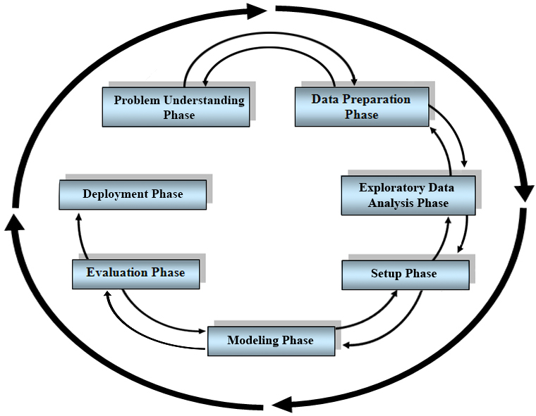
For this project, I followed a Data Science Mehodology. It is from the book Data Science Using Pyton and R by Larose and Larose.
This methodology starts by understanding the problem. But for this project, I have a dataset and will need to determine a problem it can be used for. Therefore, I will use the feedback path to define and understand the problem.
My plan is to take the project through to the Setup Phase.
From: Data Science Using Python and R – Larose & Larose

Slide 3
Problem Understanding Phase
I will be focusing on completion rates.
The data set includes data for under two-year, two year, and four-year institutions
My initial analysis will be for all of the data
My expectation is that I will focus on four-year institutions.
The data covers many types of completion metrics
I will look at completion within 150% of expected completion and 200% of expected completion

Slide 4
Data Preparation Phase
I downloaded the data from https://collegescorecard.ed.gov/data/
This is the US Department of Education College Scorecard data
The file was large. It is made up of many files. Primarily, there seems to be one file per school year. But there are other files such as Crosswalks and Field of Study. I will need to investigate these.
Step one is to upload one data set to Data Bricks
I will also look for documentation on the data
The documentation was high level. For example, it stated that they had data for completion. It turns out that there may be as many as 100 attributes related to completion. These are not documented in the data dictionary.

Slide 5
Data Preparation Phase
In addition to the files, the department offers an API.
The technical documentation for the API is in YAML.
Reading the YAML file provided me with the specific variable names, data types, and descriptions for all of the attributes

Slide 6
Exploratory Data Analysis
I loaded the data for one year to Data Bricks as a CSV file
Because the attributes change year to year, I elected to do my analysis on the one year.
I loaded the CSV file to a data frame
Initially, I developed a set of columns for my analysis
After running ydata to profile the data, there was some missing data
So, I went through several iteration of adding and removing attributes

Slide 7
Exploratory Data Analysis
With the selected attributes, I used Spark SQL to convert the data types to the correct data types based on the YAML data dictionary
I wrote the result into a Parquet file
This file was not used for this project but would be used if we continued

Slide 8
Setup Phase
The bulk of my time was spent here
I have a lot of background with SQL
But each implementation has its own unique constructs
So, it took me some time to learn specifically how Spark SQL works
In addition, I went down a path of just summarizing the data
But this was not meaningful
Once I determined to use quartiles to represent the data, it worked much better and produced meaningful results

Slide 9
Thank You

